Slide 1

Predicting Remaining Useful Life of Lithium-Ion Battery
Md Reza
&
Kirankumar Sivarajan
IE7860 Semester Project

Slide 2
Summary:
Background:
Predicting lithium-ion batteries’ useful life is crucial to managing the batteries' health and estimating the remaining useful life. With the revolutions and exponential growth of electric vehicles (EV), there are trends to develop AI/ML-based processes in predicting the remaining functional life of the battery to unleash the power of EVs in the automotive industry.
Objectives:
This project aims to develop the traditional machine learning models using TensorFlow, sci-kit learn, and other python libraries to predict the lithium-ion battery's current state of health and remaining useful life, using voltage and temperature profiles from given charging and discharging cycles. Given the data and cycle, our goal is to build different ANN models to predict the battery's remaining useful life (RUL) and evaluate the models’ performance with model-driven metrics and outcomes.
IE7860 Semester Project

Slide 3
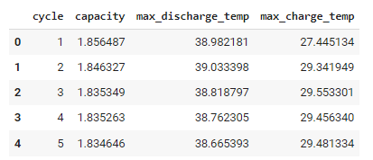
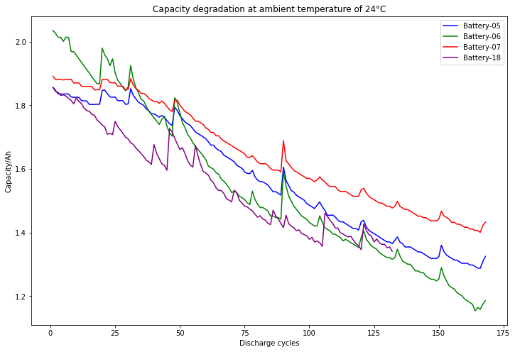
About The Dataset:
Data Source: Experiments on Li-Ion batteries. Charging and discharging at different temperatures. Records the impedance as the damage criterion. The data set was provided by the Prognostics CoE at NASA Ames.[1]
Preprocessing: It was necessary to extract features related to the battery’s charge/discharge cycle at different temperatures to develop the proposed deep learning models. A python function is written to convert the MATLAB files to python format, and additional relevant features are created to improve model performance.
Finally, data load verification is done with different charts and visualizations to check if the datasets loaded correctly.
[1] B. Saha and K. Goebel (2007). "Battery Data Set", NASA Ames Prognostics Data Repository (http://ti.arc.nasa.gov/project/prognostic-data-repository), NASA Ames Research Center, Moffett Field, CA
IE7860 Semester Project

Slide 4
Project Methodology:
TensorFlow, sklearn, Keras, SciPy, matplotlib, & seaborn packages are used to apply the following ANN:
RNN
LSTM
GRU
Split data into training and testing data sets
A function is created for train-test split & data-frame conversion. Out of four datasets
B0005, B0007, & B0018 are used for training the models
B0006 is used for testing the models
Performed permutation and reshaped the data to three dimensions to improve model performance
Training data: 474 samples
Test data: 158 samples
Measure the accuracy of each model utilizing MSE, R Squared Score & Cycle Error Actual vs. Predicted
Model Performance
Compare MSE, R Squared Score & Prediction Error to evaluate model performance
IE7860 Semester Project

Slide 5
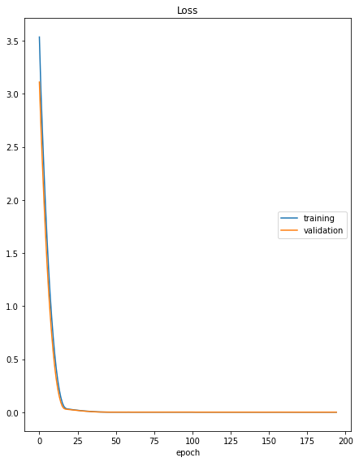

RNN
Can deal with sequential/time-series data
Recognize sequential characteristics of the dataset
Holds the knowledge about the past to forecast future values
RNN Image source: https://colah.github.io/posts/2015-08-Understanding-LSTMs/
IE7860 Semester Project

Slide 6
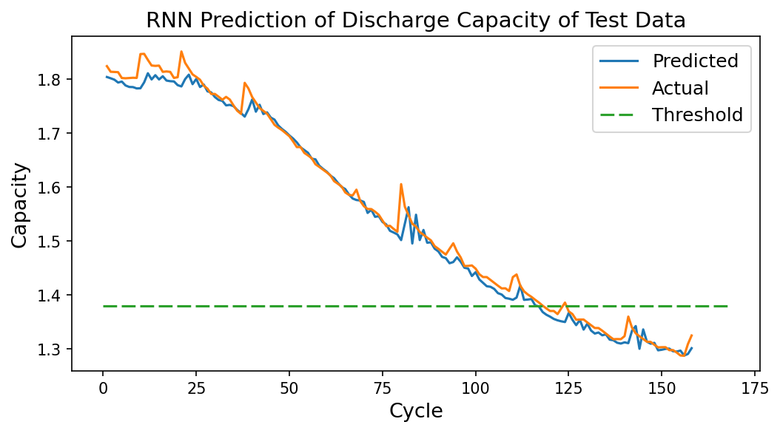
RNN
Fail at Cycle Number | Number
Actual | 116
Predicted | 118
Error of RUL | 2
Metrics | Score
MSE | 0.0004
R-2 | 0.9894
IE7860 Semester Project

Slide 7
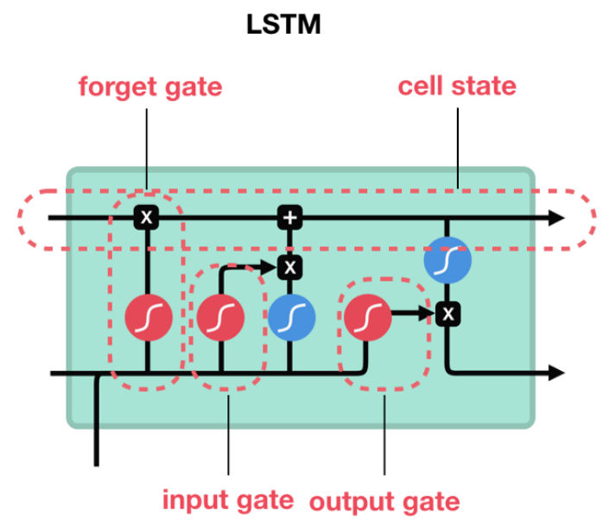
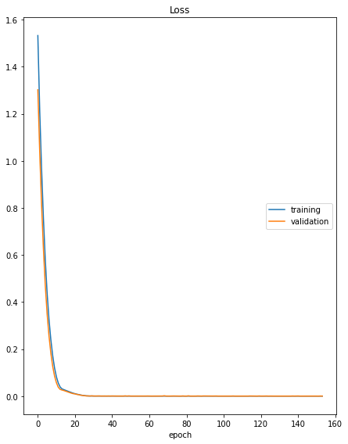
Created as the solution to short-term memory
Internal mechanisms called gates that can regulate the flow of information
The gate can learn which data sequence is essential to keep and what to remove
LSTM Image source: https://towardsdatascience.com/illustrated-guide-to-lstms-and-gru-s-a-step-by-step-explanation-44e9eb85bf21
IE7860 Semester Project

Slide 8
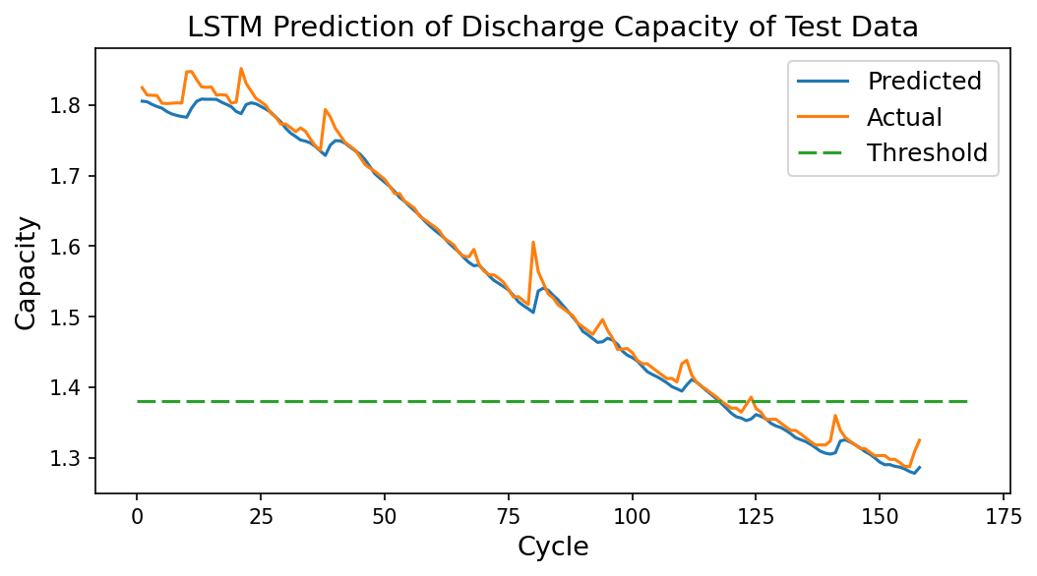
LSTM
Fail at Cycle Number | Number
Actual | 117
Predicted | 118
Error of RUL | 1
Metrics | Score
MSE | 0.0003
R-2 | 0.9907
IE7860 Semester Project

Slide 9
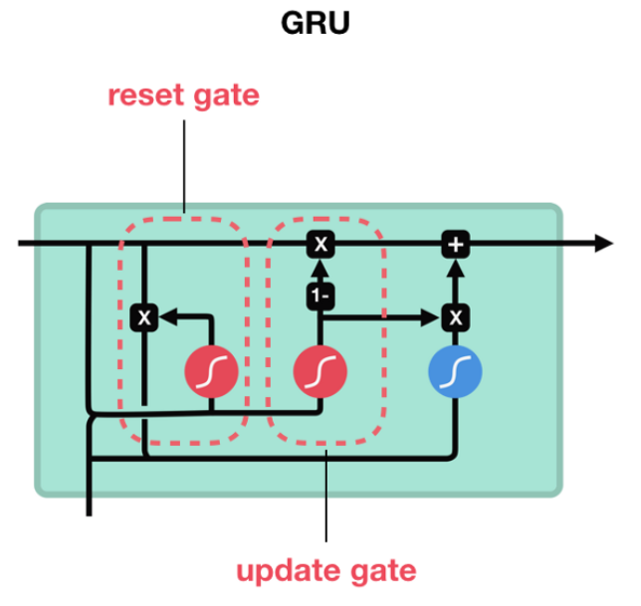
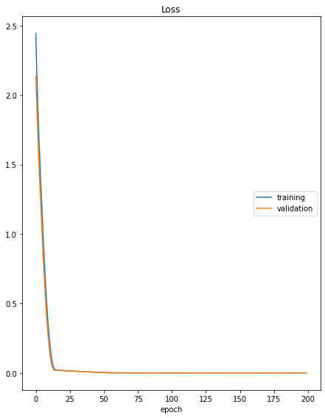
Instead of cell state and it used the hidden state to transfer information
Update Gate The update gate acts like the forget and input gate of an LSTM
Reset Gate The reset gate is used to decide how much past information to forget
GRU Image source: https://towardsdatascience.com/illustrated-guide-to-lstms-and-gru-s-a-step-by-step-explanation-44e9eb85bf21
IE7860 Semester Project

Slide 10
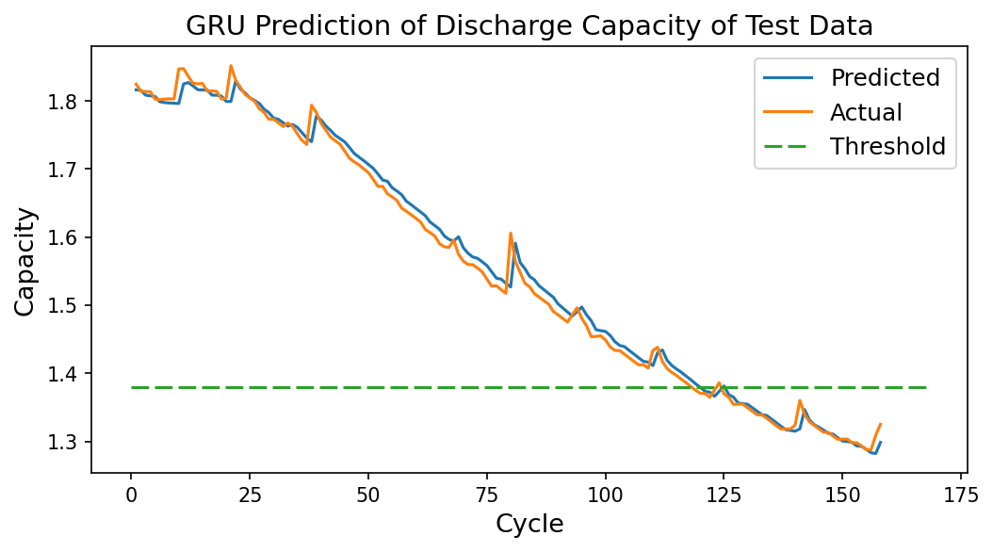
GRU
Fail at Cycle Number | Number
Actual | 119
Predicted | 118
Error of RUL | -1
Metrics | Score
MSE | 0.0002
R-2 | 0.9930
IE7860 Semester Project

Slide 11
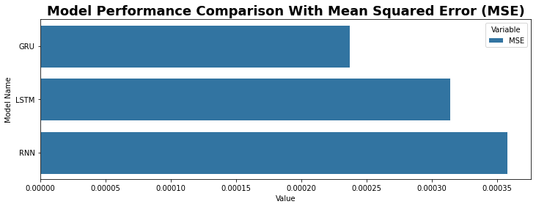
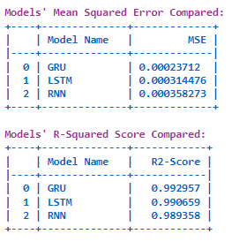
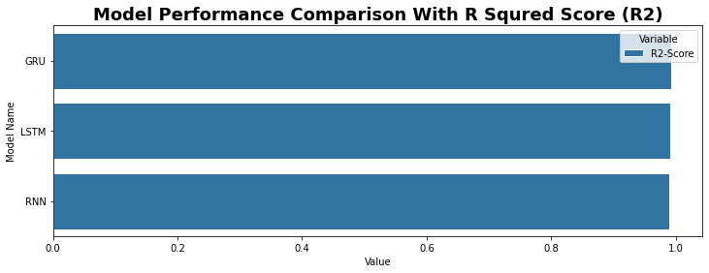
Model Performance Comparisons
IE7860 Semester Project

Slide 12
Appendix
IE7860 Semester Project

Slide 13
Explainable AI (SHAP)
Explain Individual Prediction & Features Importance Using Explainable AI (SHAP):
Model explainability becomes a fundamental part of the machine learning pipeline. Therefore, keeping the machine learning model as a “black box” is not an option anymore.
SHAP (Shapley Additive Explanations) connects optimal credit allocation with local explanations using the game-theoretic approach and classical Shapley values to explain individual predictions or output of the machine learning model.[2]
[2] Shapley sampling values: Strumbelj, Erik, and Igor Kononenko. "Explaining prediction models and individual predictions with feature contributions." Knowledge and information systems 41.3 (2014): 647-665
IE7860 Semester Project

Slide 14
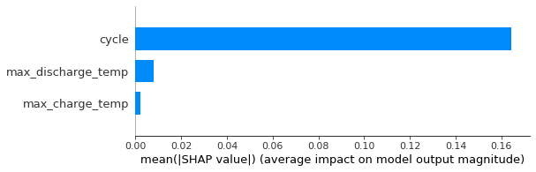
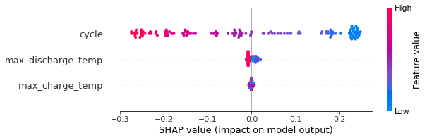
SHAP Values & Summary Plot
SHAP Values Plot: Calculates the mean of absolute SHAP values for each feature across all observations.
SHAP Summary Plot: Overcame some of the issues derived from the SHAP Mean. It combines feature importance with feature effects to highlight important relationships.
IE7860 Semester Project

Slide 15
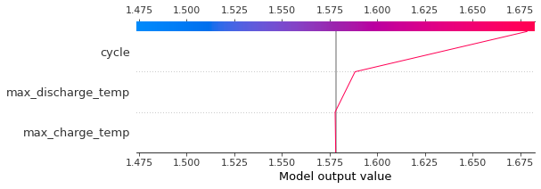
SHAP Decision & Force Plot
SHAP Decision Plot: This shows the important features of a model’s output.
SHAP Force Plot: This shows how much each feature has increased or decreased the predicted number of rings for a specific observation based on the base value (i.e., 1.58). In this case, the final predicted number is 1.68.
IE7860 Semester Project

